Slide 1

Ocular Disease Recognition
GUIDE:
MR.V.GOKULAGRISHNAN…M.E, ASSISTANT PROFESSOR, COMPUTER SCIENCE & ENGINEERING
TEAM MEMBERS:
MADHUBALAN M (DSUG20104088) MANO A (DSUG20104093)
RAKESH J (DSUG20104124) RAMKUMAR R (DSUG20104125)

Slide 2
Domain Description:
The deep learning domain encompasses a subset of machine learning techniques inspired by the structure and function of the human brain’s neural networks. Deep learning models consist of multiple layers of interconnected nodes (neurons) that process and learn from data representations in a hierarchical manner.
These models excel at tasks such as image and speech recognition, natural language processing, and more, due to their ability to automatically extract intricate patterns and features from large datasets.

Slide 3
ABSTRACT
Ocular disorders have become more prevalent throughout time, with one of the causes being changes in human behaviour patterns brought on by technology and the creation of technological equipment.
The diagnosis of ocular pathology using fundus images is a significant
difficulty in health care.
The aim of our project is to develop a combination of feature extraction methods and Neural Networks to recognize common types of visual disorders using the fundus images.
Fundus photographs are ocular documentation that record the
appearance of a patient’s retina.

Slide 4
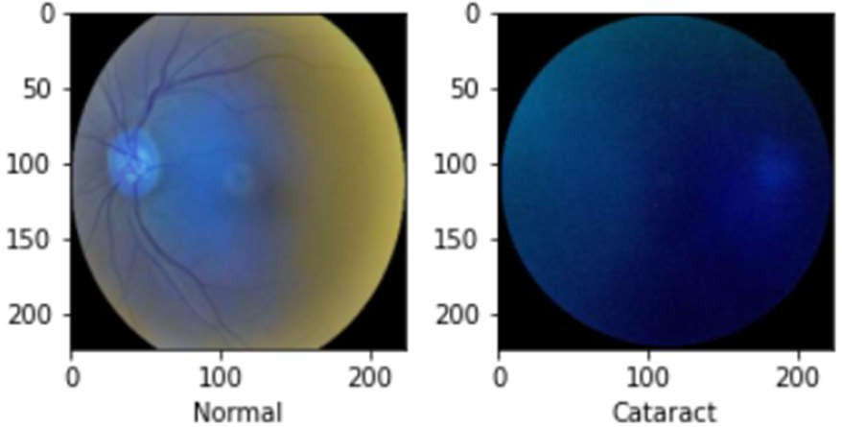
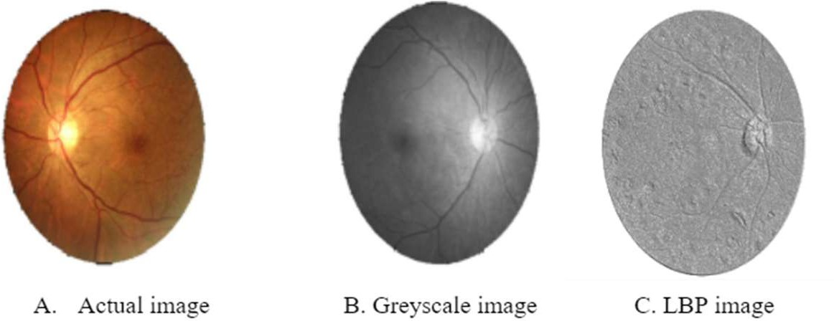
Dataset
This dataset contains 7000 images with 5000 training images and 1000 testing images.
This dataset contains various types of eye images such as Diabetes, Glaucoma, Cataract, Related Macular Degeneration, Myopia, Hypertensive Retinopathy and other ones.
The features of the image are extracted through lbp feature extractor.

Slide 5
Models
VGG19 : It is a convolutional neural network trained on a subset of the ImageNet dataset, a collection of over 14 million images belonging to 22,000 categories.It has 138 million parameters with a total of 19 layers including weights.
ResNet50 : It is a convolutional neural network that is 50 layers deep. A 7×7 kernel convolution alongside 64 other kernels with a 2-sized stride. A max pooling layer with a 2-sized stride. 9 more layers—3×3,64 kernel convolution, another with 1×1,64 kernels, and a third with 1×1,256 kernels.
Vision Transformer : It applies a Transformer-like design to selected areas of the picture. A sequence of vectors is created by dividing a picture into fixed- size patches, linearly embedding each one, adding position embeddings, and then feeding the assembled vectors to a conventional Transformer encoder.

Slide 6
S.NO | TITLE | ALGORITHM | MERITS | DEMERIST
1 | Deep Transfer Learning Strategy to Diagnose Eye Related Conditions and Diseases: An Approach Based on Low-Quality Fundus Images | Convolutional Neural Network (CNN) | Efficient use of resources | Overfitting & Limited adaptivity
2 | A Novel Meibomian Gland Morphology Analytic System Based on a Convolutional Neural Network | Convolutional Neural Network (CNN) | Automated analysis | Dependency on Training Data Quality

Slide 7
S.NO | TITLE | ALGORITHM | MERITS | DEMERIST
3 | A Novel System for Ocular Surface Temperature Measurement and Tracking | Visual & Image Ranking | Non-Invasive Monitoring | Accuracy and Precision
4 | An Optimal Visual Fatigue Relief Method for Workers Considering Rest Time Allocation | Analytic model development | Customized Rest Time Allocation | Privacy and Ethical Considerations

Slide 8
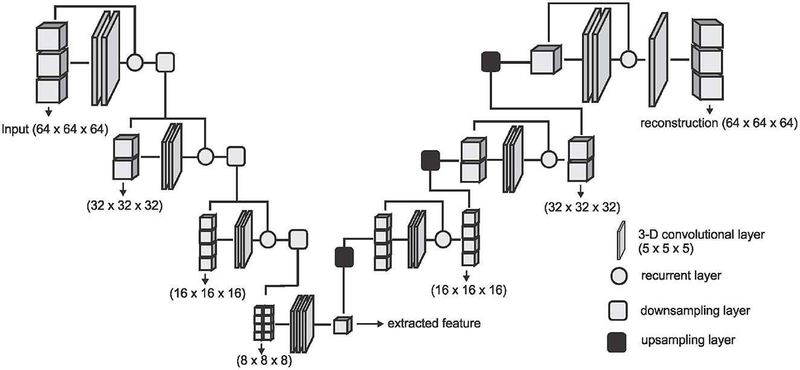
Architecture Of Algorithm
This Photo by Unknown Author is licensed under CC BY
LOCAL BINARY PATTERN

Slide 9
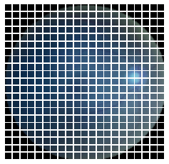
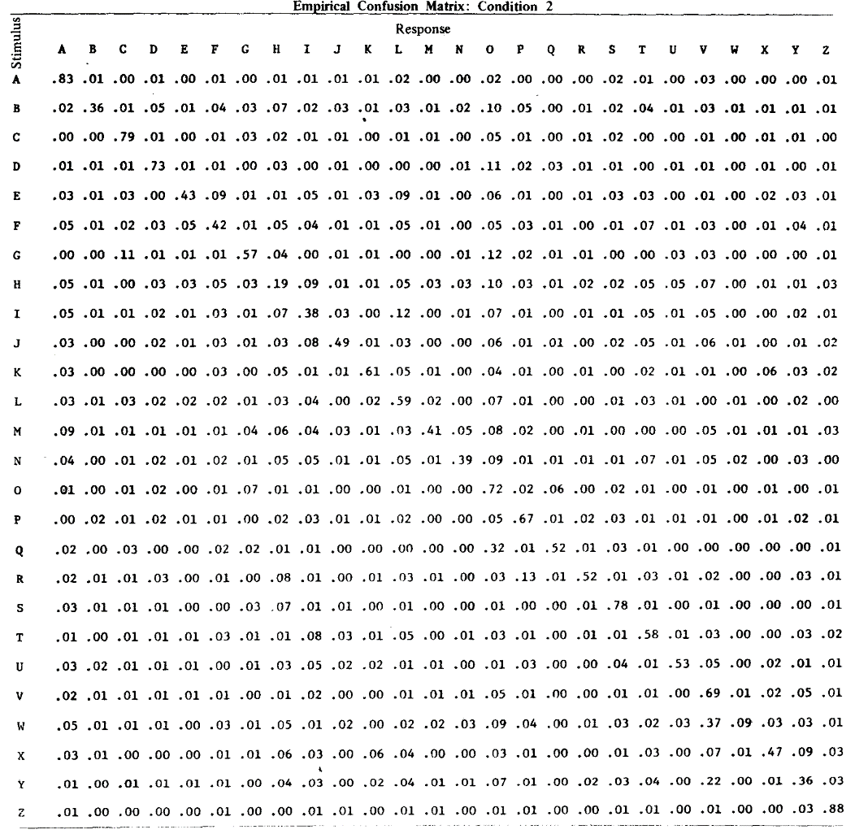
Transform Pixels into Values
This Photo by Unknown Author is licensed under CC BY-SA

Slide 10
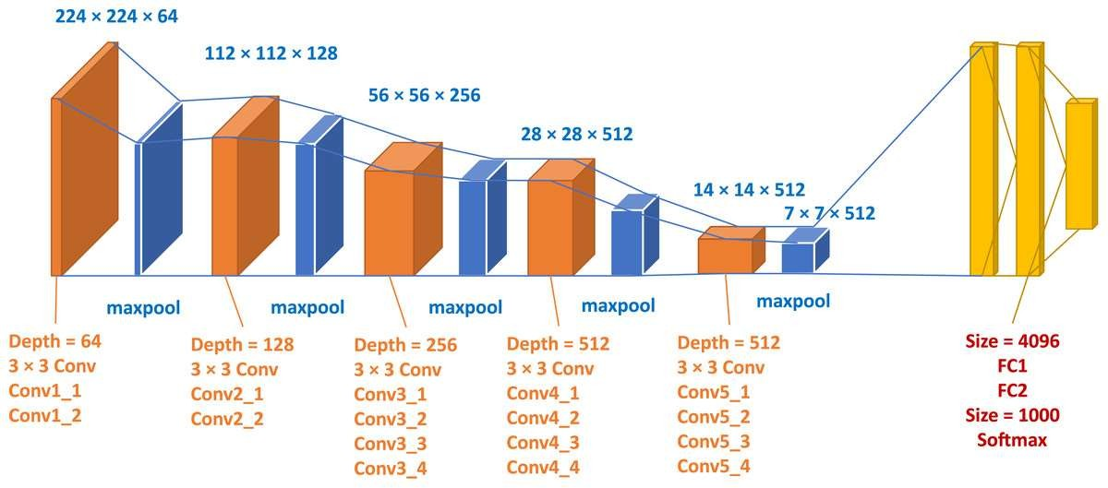
Architecture Of VGG 19
Existing Models
This Photo by Unknown Author is licensed under CC BY

Slide 11
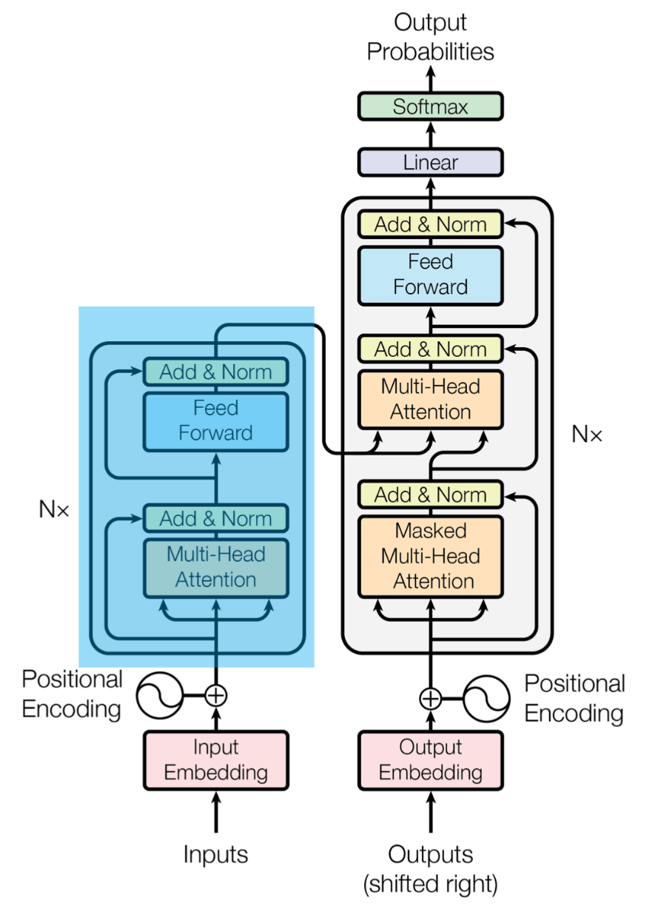
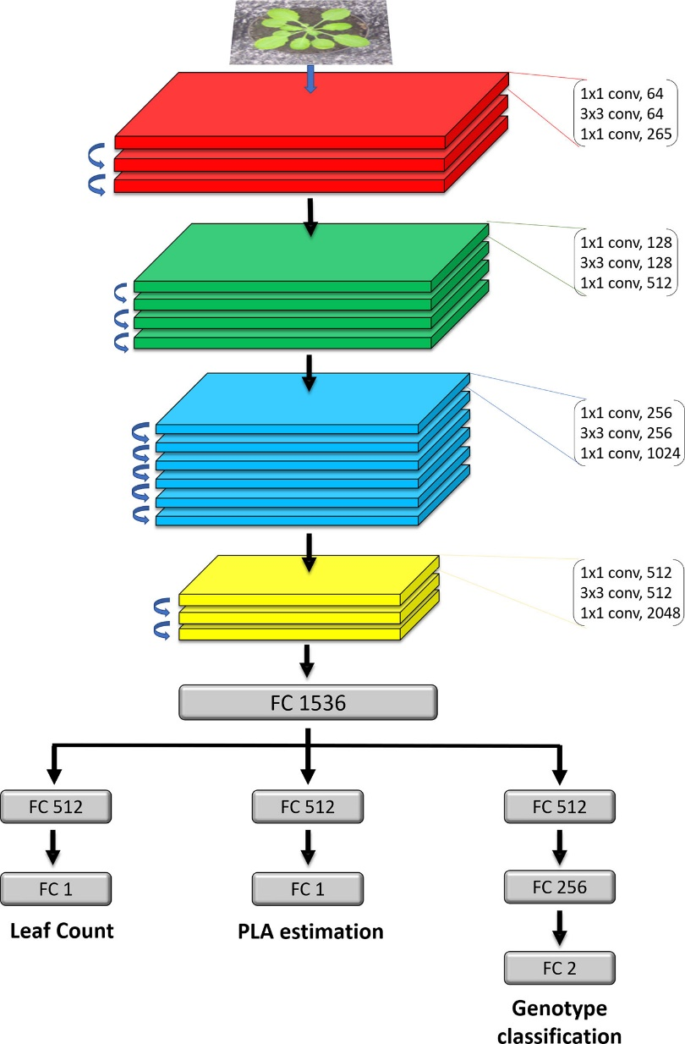
ResNet 50 & Vision Transformer
This Photo by Unknown Author is licensed under CC BY
This Photo by Unknown Author is licensed under CC BY-NC

Slide 12
THANK YOU

